Slide 1
Are flights going to/coming from the North delayed more?
Databases Group Project WS 23/24
Group U: Wilson Liu, Cajus Marvin Schneider
Objective 1: Wilson Liu
Objective 2: Cajus Schneider
Objective 3: Wilson Liu
Objective 4: Cajus Schneider

Slide 2
Concept
Dataset: 2015 Flight Delays and Cancellations (link)
Research problem: We would like to investigate whether flights coming from/going to more northern airports typically have longer delays and to what extent? Our current plan to answer this is by ingesting the data from .csv files to a SQL-based database, making the relevant queries on airport latitude, delay time, etc., and graphing the relationship using libraries like Pandas or Seaborn.
Motivation: In Canada there is a common rumor, concerning this research problem. We are curious to see whether this common rumor is based in fact and statistics.
Method: A relational database is ideal for this project as we will need to search for and connect information about two different entities – airports and flights. Also, you have multiple entities with more complex relationships (e.g., 1:M), which would not naturally lend itself to being represented in a spreadsheet or just one .csv file. The airlines and airports can be saved as foreign keys in the flights relation, which naturally comes from the dataset.

Slide 3
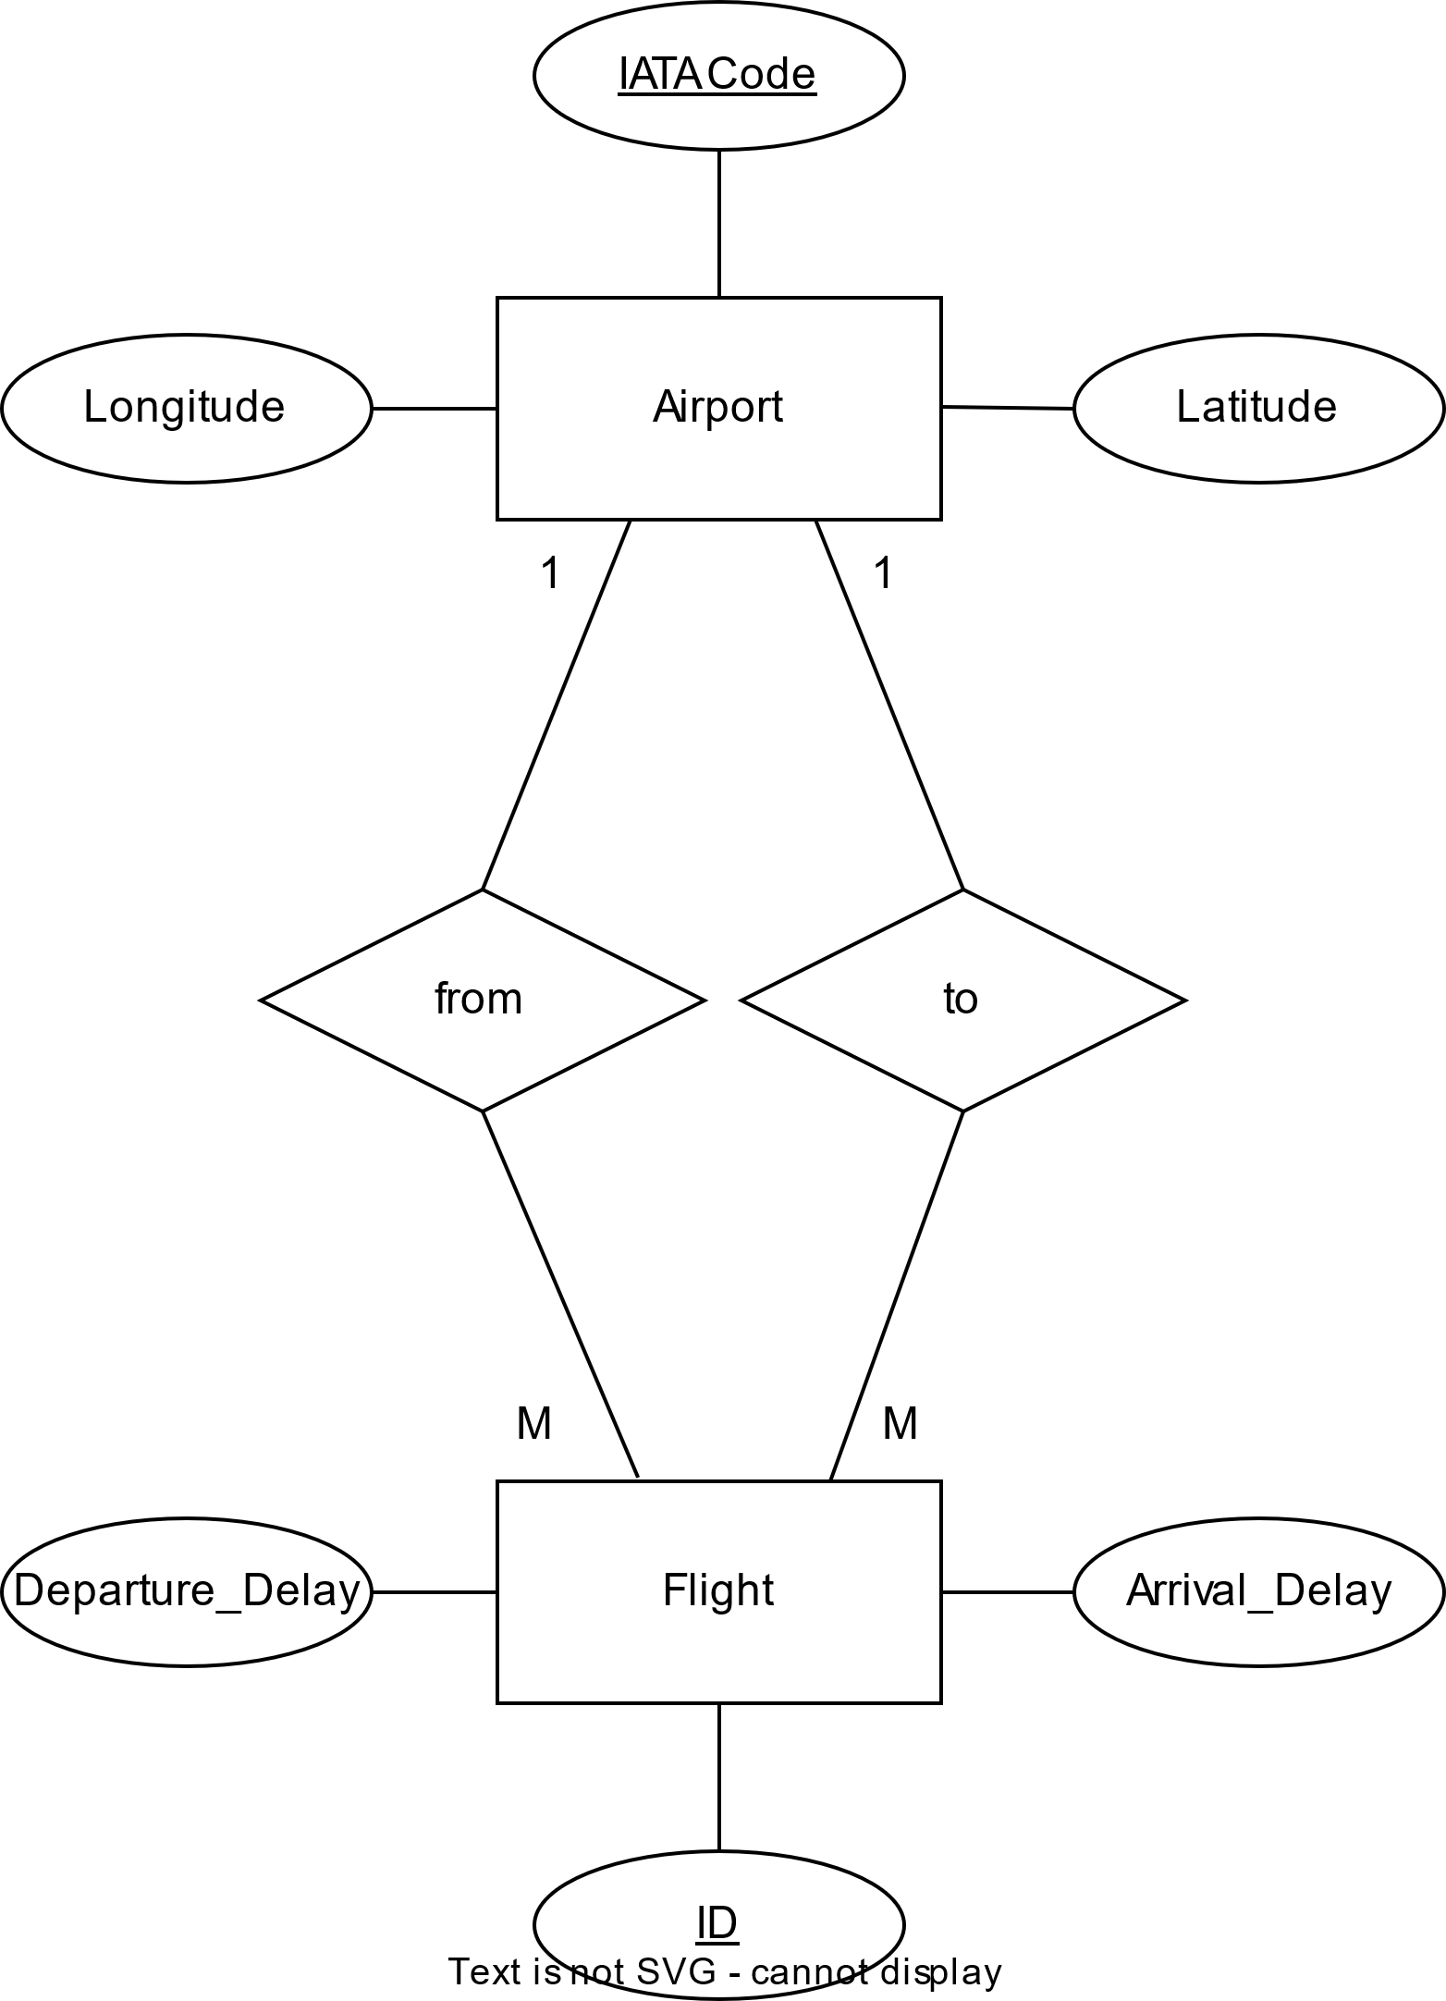
Objective 2 – data modeling and data ingestion
/*Downloaded Datasets*/
/*Create Entities*/
CREATE TABLE Airport(
IATA_CODE VARCHAR(8) PRIMARY KEY,
LONGITUDE FLOAT,
LATITUDE FLOAT
);
CREATE TABLE Flight(
ID SERIAL PRIMARY KEY,
DEPARTURE_DELAY FLOAT,
ARRIVAL_DELAY FLOAT,
ORIGIN_AIRPORT VARCHAR(8),
DESTINATION_AIRPORT VARCHAR(8),
FOREIGN KEY (ORIGIN_AIRPORT) REFERENCES Airport(IATA_CODE) ON DELETE CASCADE,
FOREIGN KEY (DESTINATION_AIRPORT) REFERENCES Airport(IATA_CODE) ON DELETE CASCADE);
/*Ingest Airport Data
Using temporary table to load .csv file*/
/*Create temporary table*/
/*Load .csv file in Temporary Table*/
/*ingest data from temporary table into Airport table*/
/*Ingest Flight Data
Using temporary table to load .csv file*/
/*Create temporary table*/
/*Load data from temporary table*/
/*ingest data from temporary table into Flight table*/
/*Not importing tuples where FK Values are missing (caused an error before)*/
/*Delete temporary tables*/

Slide 4
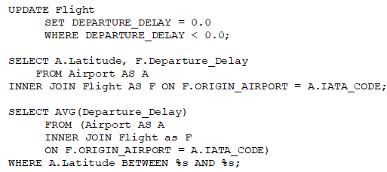
Objective 3 – database queries
To quantify 'delay', for the purposes of this study we defined it as departure delay.
Early flight departures (with a negative value for Departure_Delay) were set to a value of 0, so as to not skew the average delay time.
To get an accurate picture of whether latitude is correlated with flight delay, we calculated the average delay in blocks of 5 degrees latitude.

Slide 5
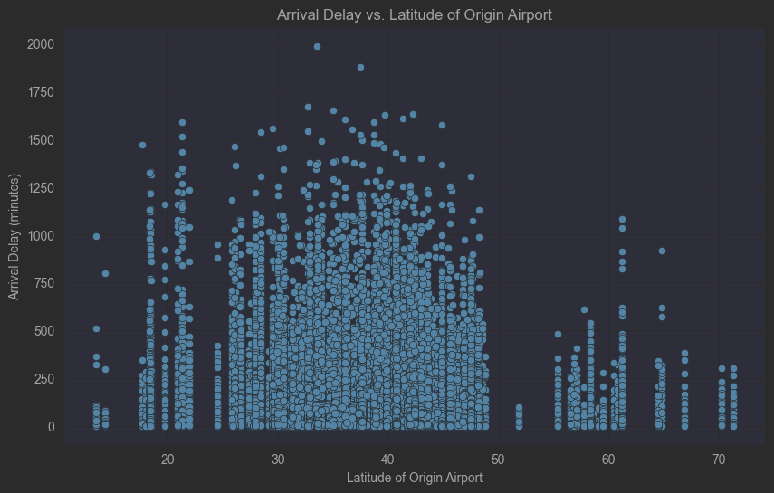
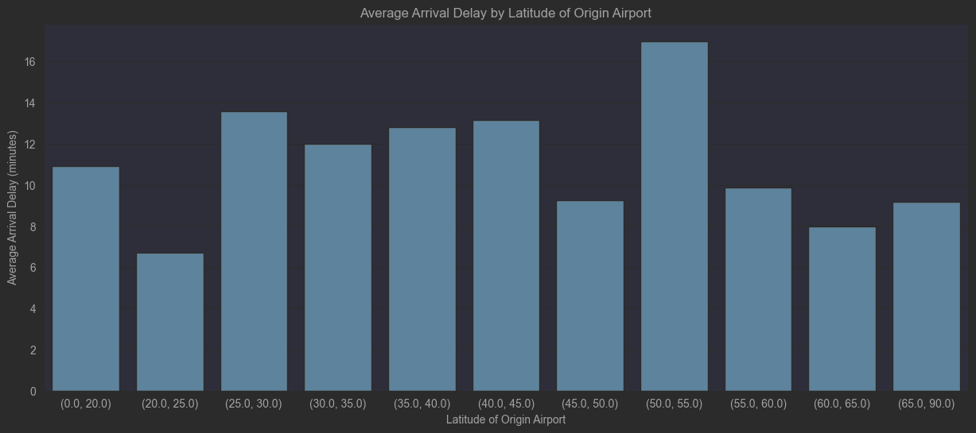
Objective 4
Using a mix of JDBC Prepared Statements (Statement 1,2) and JDBC Callable Statements (Statement 3) we processed the data using pandas, matplotlib and seaborn libraries. After executing the first Statement, we plot all arrival delays vs. the latitudes of the Origin Airport. We cannot see any correlation (corr = 0.00). We then call Statement 3 by passing a list of parameters for the „%s“ placeholder. These parameters group airports by latitude and calculate a average. Again, we cannot see any correlation (corr = -0.06). We fail to reject the H0: there is no relationship between the latitude of the airport and the departure delay. Further investigation could focus on the relative number of flights that have a delay, coming from the North or control for the winter months only.

Slide 6
reproducibility
https://github.com/Rennacker54/Databases_Group-U/

Slide 7
Remarks
(Obj 2) We should/colud update the ER model (we are not using Longitude, Arrival Delay, Target Airport also unneccessary)
We could also argue to keep them so in future we can control for more inflencial factors on delay (e.g.flight direction, specific airports, …)
(Obj 3) I altered the Queries as in the screenshot – (1) set negative delays == 0; (2) query all delays by latitude (used for scatterplot; (3) added %s parameter to call statement from python directly (better for further processing/altering of parameters)
(Obj 4) Theoretically we could control whether there are MORE delays form notrhern Airports, neglecting the actual minute count -> e.g. 20% of flights from the north are delayed / we could also control for winter months etc.
Ideas: query the delays by month? Are flights in winter more delayed? I am not sure how many queries we should have

